Slide 1

Code Club 10/23/23

Slide 2
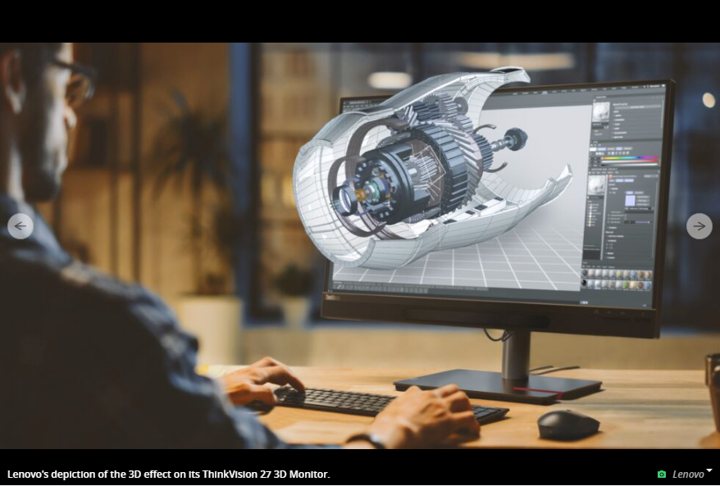
This week in tech:
Apple announced a cheaper vision pro headset
Tesla Cybertruck got a new release date
November 30th
Tesla now also has an official API for apps
Microsoft Project Silica
Microsoft wants to store petabytes of data on glass plates in Antarctica for 10,000 years.
Netflix tries game streaming

Slide 3

Advanced HTML

Slide 4
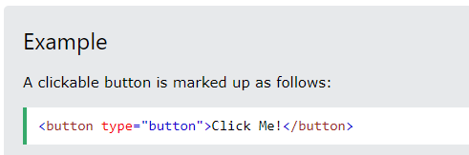
Buttons
Things you can click on
Different tags can be inside of the button tag to format text
Often stylized with CSS!
The default button is pretty simple

Slide 5
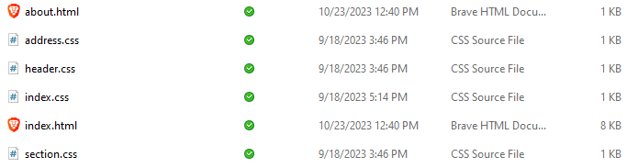
More Pages
Each page is a different HTML file
Can be sorted into folders for more organization as well
Links can be made using the <a> tag with href=[FILE]

Slide 6
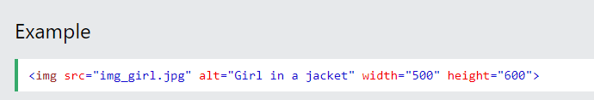
Images
<img> tag displays any kind of images on your webpage!
Use src= to define the name/location of the file
Width and height tags exist to define the size

Slide 7
Get started!
https://www.w3schools.com/html/html_basic.asp
Notes:
Reminder to download html live server extension

